Slide 1
Product H00k Model Deck
PREPARED BY: SHAMPA RANI DAS
A Framework for Habit-Forming Products

Slide 2
Why Habit Formation Matters
Higher retention
  Retention is how many users continue using your product over time.
Lower Customer Acquisition Cost
  CAC = The money spent to acquire one new user (ads, marketing, sales).
Better Lifetime Value
  LTV = How much a user is worth over their full journey with your product.
Strong competitive moat
  This creates emotional and behavioral lock-in, making users less likely to switch to competitors, even if alternatives appear.
Daily engagement
  Daily active usage is the strongest sign of habit formation.

Slide 3
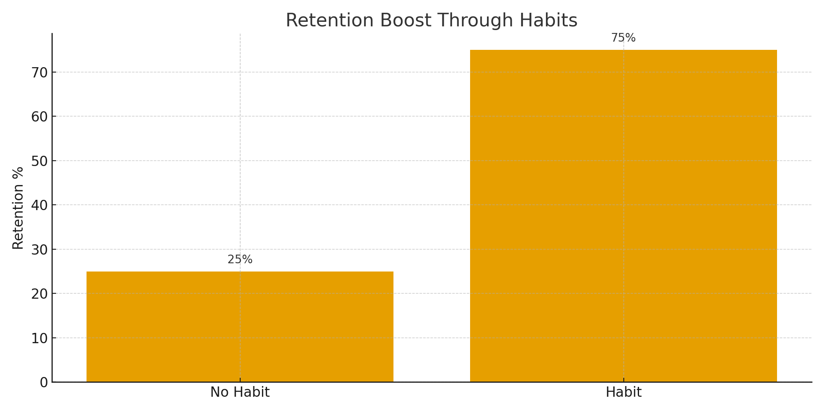
Retention Boost Through Habits

Slide 4
Hooked Cycle
Trigger – What prompts the user to act (external cues at first, but eventually internal emotions or routines).
Action – The simplest behavior a user performs in anticipation of a reward.
Variable Reward – A satisfying, but unpredictable outcome that keeps users interested and coming back.
Investment – The user puts something into the product (data, time, effort, customization), increasing its personal value and making future engagement more likely.

Slide 5
Trigger: Spark the User’s Behavior
External Triggers
Notifications
Emails
Reminders
Social cues
Internal Triggers
Feelings like boredom, pressure, curiosity, stress, and so on.
Routines like commuting, studying, or checking the phone.
These create habit loops, where users open the product without being prompted.

Slide 6
Action: User Behavior Toward a Reward
Reduce friction → Faster actions → Higher engagement
People take action when:
Users are motivated
Users have the ability (ease, simplicity)
Users are prompted
Actions must be:
Fast
Intuitive
Low effort

Slide 7
Variable Reward: Keep Users Emotionally Engaged
• Social rewards • Content discovery • Mastery progress
The brain craves uncertainty.
It makes the reward more compelling.

Slide 8
Investment: Increase the Product’s Value Over Time
Users invest time, data, and preferences → Increasing product value.
Why Investment Is Powerful
Makes the product smarter and more personalized.
Triggers tailored notifications and reminders.
Enhances recommendation accuracy.
Raises the switching cost, users don’t want to lose what they’ve built.

Slide 9
Habit Loop Overview
Trigger
Action
Reward
Investment

Slide 10
Impact on Business Metrics
Improved DAU/MAU ratio
Reduced churn
Higher session frequency
Better conversion to premium

Slide 11
Strategic Advantage
Habit formation creates defensibility:
Emotional stickiness
Organic retention
Predictable engagement

Slide 12
Final Takeaway
The Hook Model transforms products into daily essentials.

